Slide 1
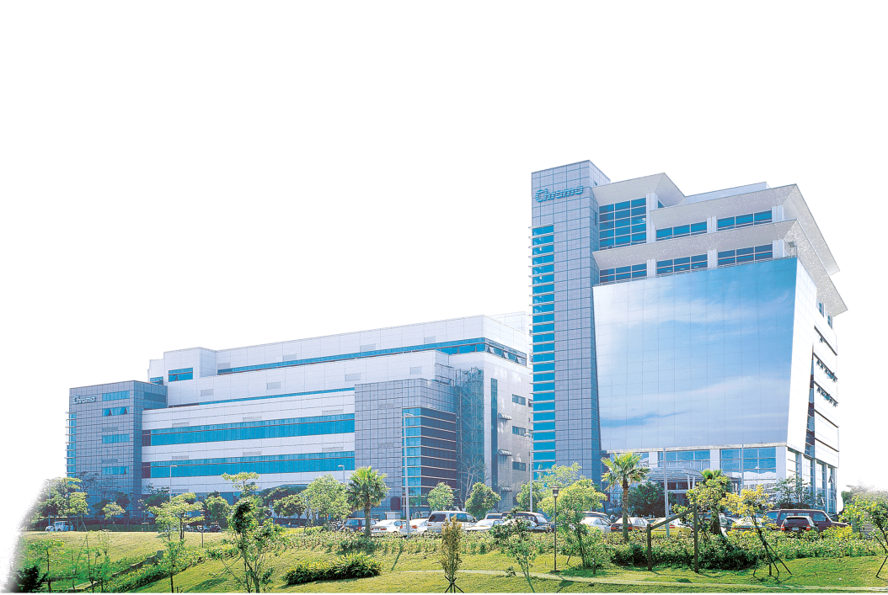

Working on Better Solutions
2012
MES教育訓練-
Create User &Tablespace
2020.04.30

Slide 2
Outline
查詢DEFAULT Tablespace
查詢DataFile路徑
Datafile設定成autoextend on
查詢Datafile是否設定成autoextend on
建立User和給予連接資料庫權限
查詢Table所存在的實體檔案位置
DataPump Export&Import前置作業

Slide 3
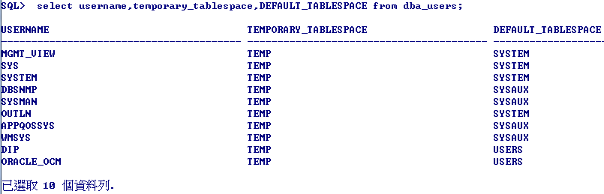
查詢DEFAULT Tablespace
SQL> set linesize 160
SQL> col temporary_tablespace format a40
SQL> col username format a40
SQL> select username,temporary_tablespace,DEFAULT_TABLESPACE from dba_users;

Slide 4
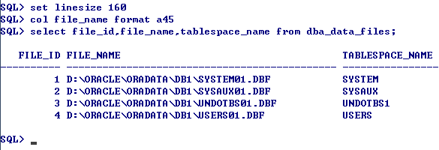
查詢DataFile路徑
SQL> set linesize 160
SQL> col file_name format a45
SQL> select file_id,file_name,tablespace_name from dba_data_files;

Slide 5
Datafile設定成autoextend on
SQL> set linesize 160
SQL> col PROPERTY_NAME format a40
SQL> col DESCRIPTION format a40
SQL> col PROPERTY_VALUE format a40
select * from database_properties where property_name='DEFAULT_TEMP_TABLESPACE';
select tablespace_name,file_name,bytes/1024/1024 file_size,autoextensible from dba_temp_files;
SQL> alter database tempfile 'O:\MES_ORACLE\oradata\ATLP\TEMP1.DBF' autoextend on;
已更改資料庫.

Slide 6
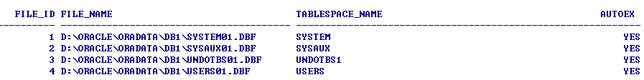
查詢Datafile是否設定成autoextend on
SQL> set linesize 160
SQL> col file_name format a40
SQL> select file_id,file_name,tablespace_name,AUTOEXTENSIBLE from dba_data_files;
SQL> set linesize 160
SQL> col file_name format a40
select tablespace_name,file_name,bytes/1024/1024 file_size,autoextensible from dba_temp_files;

Slide 7
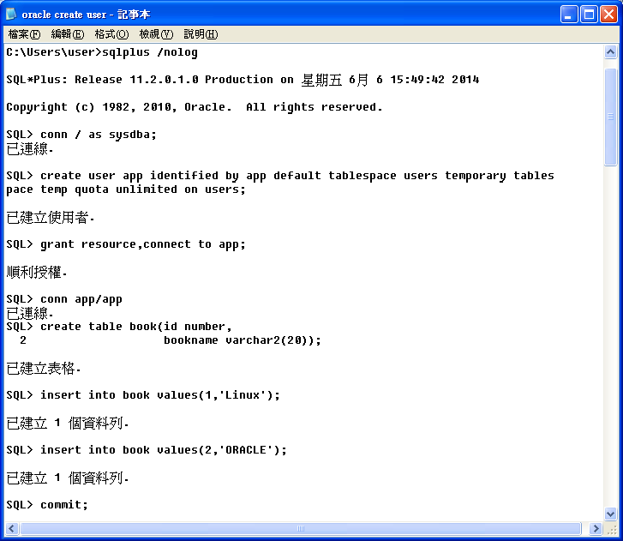
建立User和給予連接資料庫權限

Slide 8
查詢Table所存在的實體檔案位置
set linesize 160;
col table_name format a20
col owner format a10
col file_name format a40
col tablespace_name format a40
select b.file_id,b.file_name,a.table_name,a.owner,a.tablespace_name
from dba_tables a,dba_data_files b
where a.tablespace_name=b.tablespace_name
and a.table_name='BOOK';

Slide 9
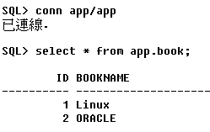
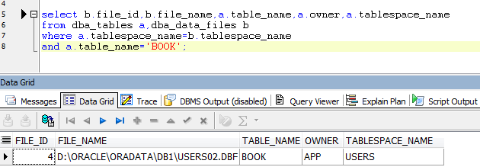
DataPump Export&Import前置作業
驗證Book Table存在實體OS DataFile裡

Slide 10
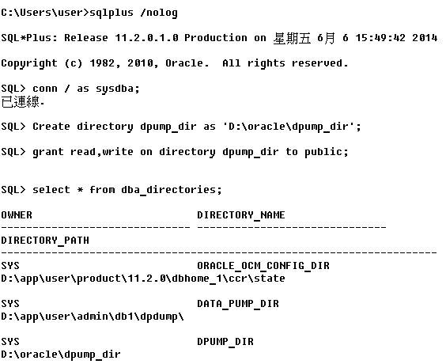
DataPump Export&Import前置作業
建立Directories並給予OS Read&Write權限

Slide 11
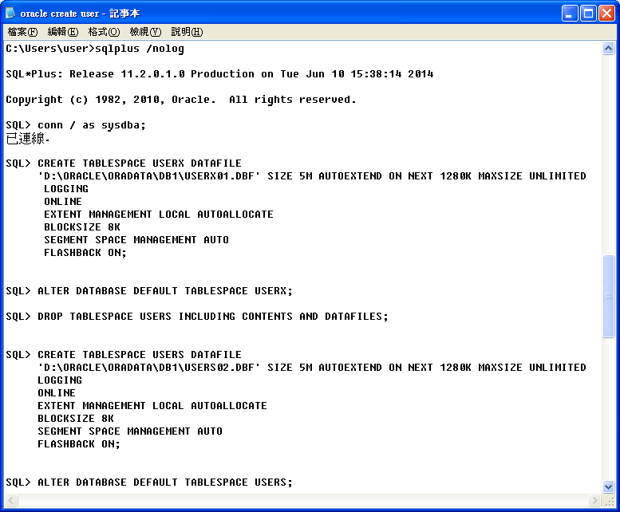
Import from Export File前置作業
刪除USERS Tablespace併重建USERS Tablespace

Slide 12


www.chromaate.com
Thank you very much

